Slide 1

Milestone 2 Noah Kim

Slide 2
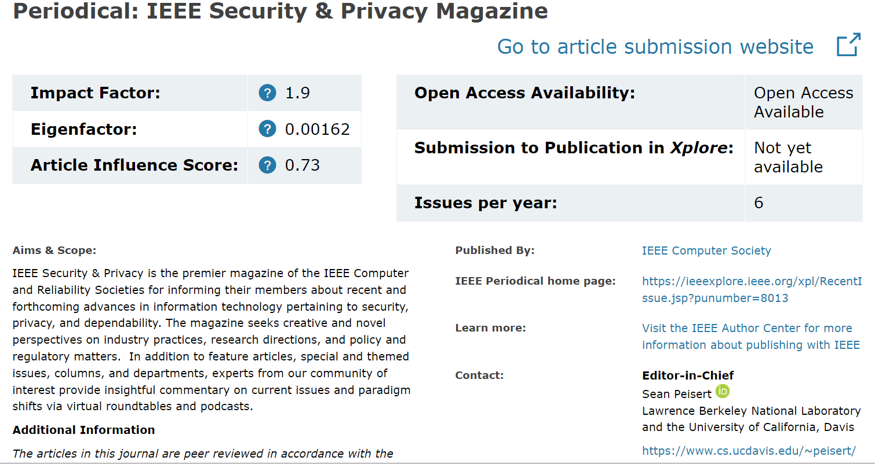
Periodical Chosen

Slide 3
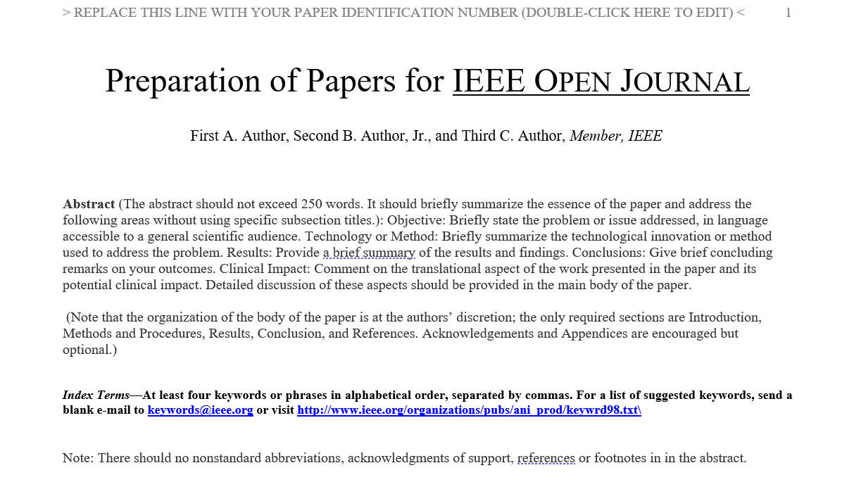
Paper Template Chosen

Slide 4
Progress Made
Uploaded a paper on the types of malware that I still am editing
Uploaded a paper on physical security that is still being worked on
Still have papers on other topics that are not ready to be uploaded

Slide 5
Things to do
Work on the rest of the topics and explore more into the countermeasures of cybersecurity
Look into talking to a cybersecurity professional to gain their experiences working in the field for a separate paper
Change my other papers into the new template that was chosen during this milestone and upload them into github

